Slide 1
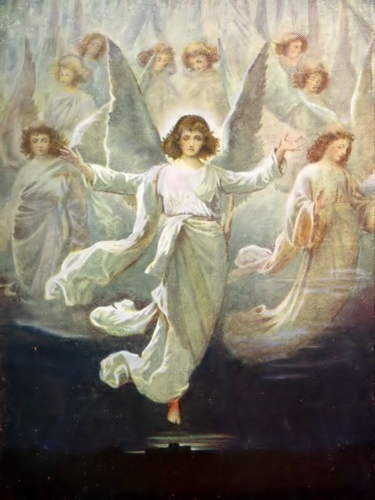
The Announcement of the Good News
Luke 1:26-38

Slide 2
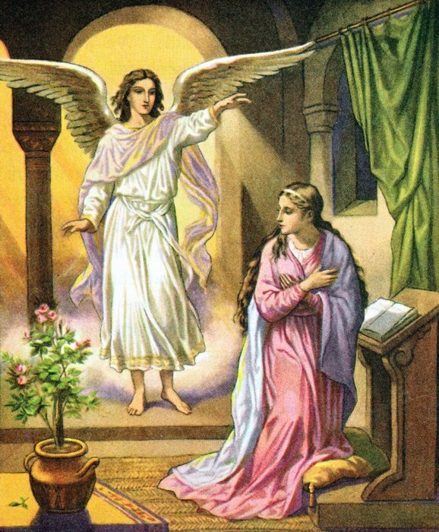
1. The angels announced the coming of a Savior.

Slide 3
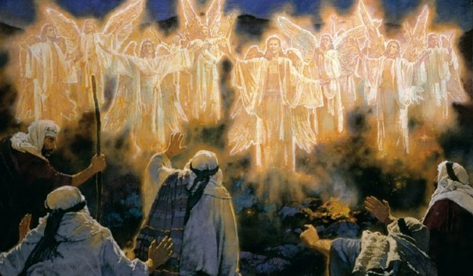
2. The angels announced the birth of a Savior.

Slide 4
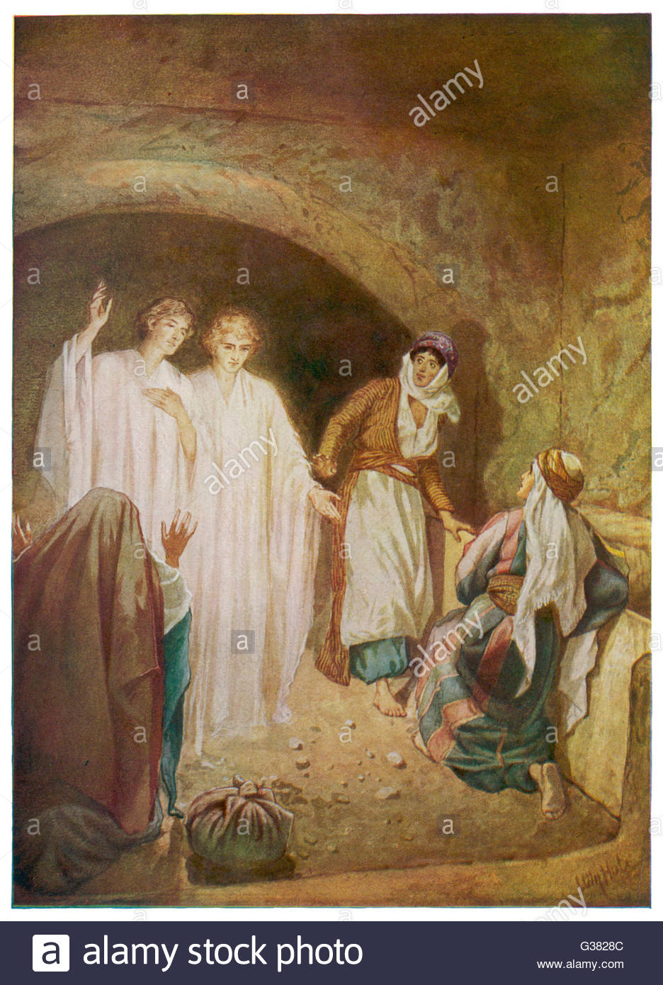
3. The angels announced the resurrection of a Savior.

