Slide 2
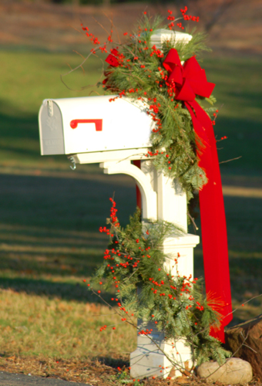
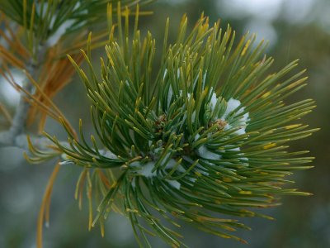
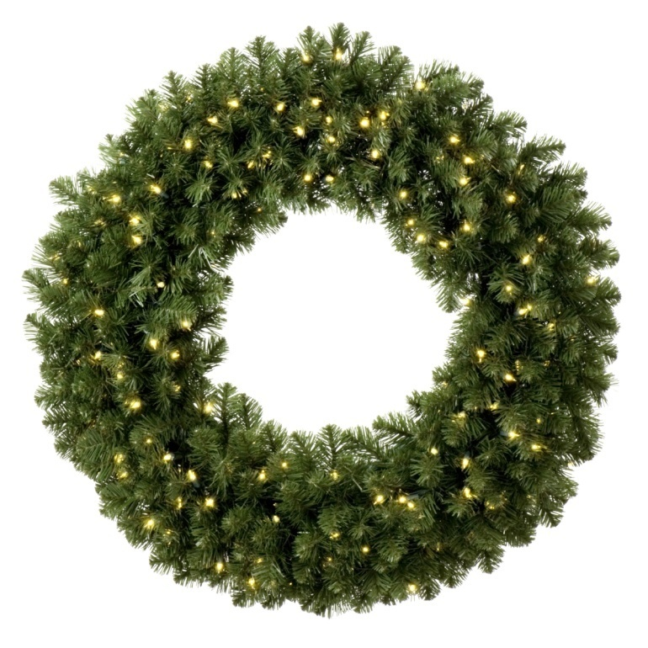
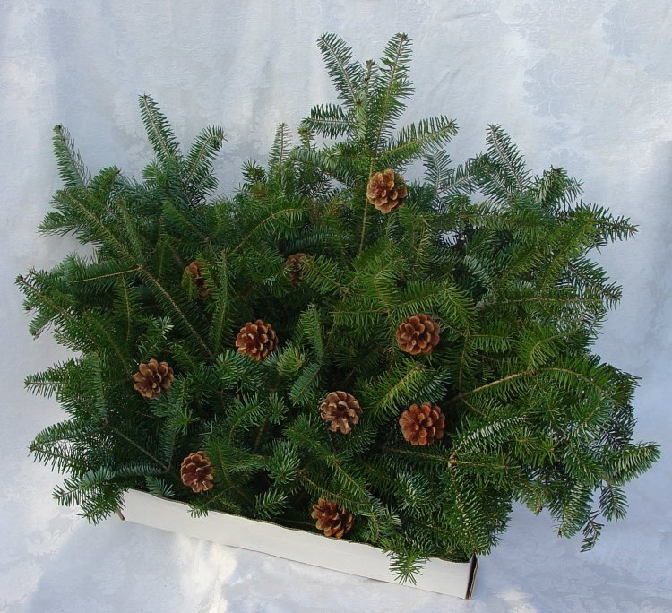
EVERGREENS

Slide 3
Isaiah 9:6-7—For to us a child is born, to us a son is given, and the government will be on his shoulders. And he will be called Wonderful Counselor, Mighty God, Everlasting Father, Prince of Peace.

Slide 4
Of the greatness of his government and peace there will be no end. He will reign on David’s throne and over his kingdom, establishing and upholding it with justice and righteousness from that time on and forever.

Slide 5
EVERGREENS

Slide 6
SONG: O Christmas Tree
O Christmas Tree! O Christmas Tree!
Thy leaves are so unchanging;
O Christmas Tree! O Christmas Tree!
Thy leaves are so unchanging;
Not only green when summer's here,
But also when 'tis cold and drear.

Slide 7
O Christmas Tree! O Christmas Tree!
Thy leaves are so unchanging!
O Christmas Tree! O Christmas Tree!
How richly God has decked thee!
O Christmas Tree! O Christmas Tree!
How richly God has decked thee!
Thou bidst us true and faithful be,
And trust in God unchangingly.
O Christmas Tree! O Christmas Tree!
How richly God has decked thee! !"

Slide 8
EVERGREENS

Slide 9
CANDY CANES

Slide 10
Deck the Halls
Deck the halls with boughs of holly, Fa la la la la la la la! 'Tis the season to be jolly, Fa la la la la la la la! Fa la la la la la la la!

Slide 11
Don we now our gay apparel, Fa la la la la la la la! Troll the ancient Yuletide carol, Fa la la la la la la la!

Slide 12
See the blazing yule before us, Fa la la la la la la la! Strike the harp and join the chorus, Fa la la la la la la la!

Slide 13
Follow me in merry measure, Fa la la la la la la la! While I tell of Yuletide treasure, Fa la la la la la la la!

Slide 14
CANDY CANES

Slide 15
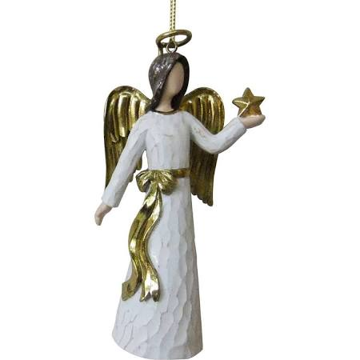
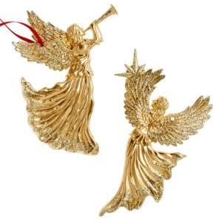
ORNAMENTS

Slide 16
Isaiah 9:6—For to us a child is born, to us a son is given, and the government will be on his shoulders. And he will be called Wonderful Counselor, Mighty God, Everlasting Father, Prince of Peace.

Slide 17
Hark the herald angels sing
"Glory to the newborn King! Peace on earth and mercy mild God and sinners reconciled" Joyful, all ye nations rise

Slide 18
Join the triumph of the skies With the angelic host proclaim: "Christ is born in Bethlehem"

Slide 19
Hark! The herald angels sing
"Glory to the newborn King!"

Slide 20
Christ by highest heav'n adored Christ the everlasting Lord! Late in time behold Him come Offspring of a Virgin's womb

Slide 21
Veiled in flesh the Godhead see Hail the incarnate Deity Pleased as man with man to dwell

Slide 22
Jesus, our Emmanuel Hark! The herald angels sing "Glory to the newborn King!"

Slide 23
Born to give them second birth Hark! The herald angels sing "Glory to the newborn King!"

Slide 24
ORNAMENTS

Slide 25
The Nativity

Slide 26
John 1:14—The Word became flesh and made his dwelling among us. We have seen his glory, the glory of the one and only Son, who came from the Father, full of grace and truth.

Slide 27
The Nativity

Slide 28
Away in a Manger
Away in a manger, no crib for a bed, The little Lord Jesus laid down his sweet head.

Slide 29
The stars in the sky looked down where he lay, The little Lord Jesus asleep in the hay.

Slide 30
The cattle are lowing, the baby awakes, But little Lord Jesus no crying he makes.

Slide 31
I love Thee, Lord Jesus, look down from the sky And stay by my cradle til morning is nigh.

Slide 32
Be near me, Lord Jesus, I ask Thee to stay Close by me forever, and love me, I pray.

Slide 33
Bless all the dear children in thy tender care, And take us to heaven, to live with Thee there.

Slide 34
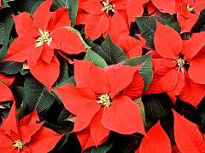
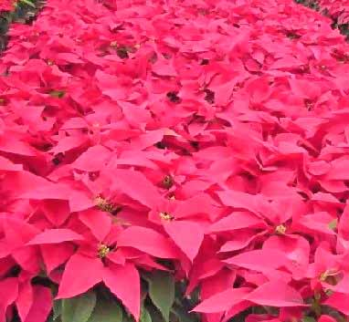
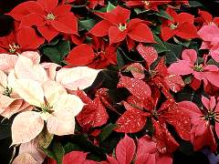
“Flower of the Holy Night”… POINSETTA

Slide 35
Matthew 2:1-2—After Jesus was born in Bethlehem in Judea, during the time of King Herod, Magi from the east came to Jerusalem and asked, “Where is the one who has been born king of the Jews? We saw his star when it rose and have come to worship him.

Slide 36
O come all ye faithful Joyful and triumphant O come ye o come ye To Bethlehem Come and behold Him Born the King of angels

Slide 37
O come let us adore Him O come let us adore him O come let us adore Him Christ the Lord

Slide 38
Sing choirs of angels Sing in exultation Sing all ye bright Host Of heaven above Glory to God All glory in the highest

Slide 39
O come let us adore Him O come let us adore him O come let us adore Him Christ the Lord

Slide 40
“Flower of the Holy Night”… POINSETTA

Slide 41
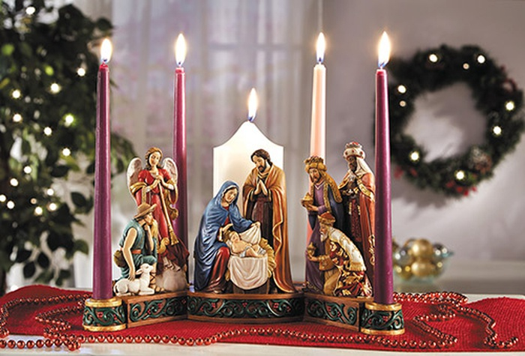
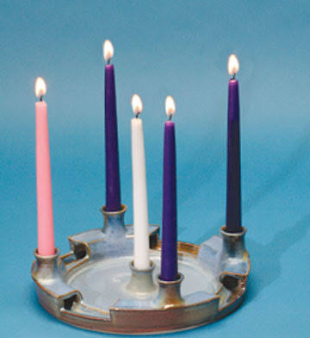
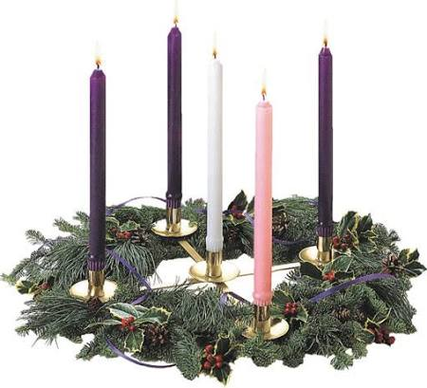
CANDLES

Slide 42
John 1:1-5—In the beginning was the Word, and the Word was with God, and the Word was God. He was with God in the beginning.

Slide 43
Through him all things were made; without him nothing was made that has been made. In him was life, and

Slide 44
that life was the light of all mankind. The light shines in the darkness, and the darkness has not overcome it.

Slide 45
CANDLES

Slide 46
The Light of the world is Jesus
The whole world was lost in the darkness of sin, The Light of the world is Jesus! Like sunshine at noonday, His glory shone in; The Light of the world is Jesus!

Slide 47
Come to the light, ’tis shining for thee; Sweetly the light has dawned upon me; Once I was blind, but now I can see: The Light of the world is Jesus!

Slide 48
CANDLES

Slide 49
HOLLY AND IVEY

Slide 50
Isaiah 53:1-6—Who has believed our message and to whom has the arm of the LORD been revealed? He grew up before him like a tender shoot, and like a root out of dry ground.

Slide 51
He had no beauty or majesty to attract us to him, nothing in his appearance that we should desire him. He was despised and rejected by mankind, a man of suffering, and familiar with pain.

Slide 52
Like one from whom people hide their faces he was despised, and we held him in low esteem. Surely he took up our pain and bore our suffering, yet we considered him punished by God, stricken by him, and afflicted.

Slide 53
But he was pierced for our transgressions, he was crushed for our iniquities; the punishment that brought us peace was on him, and by his wounds we are healed.

Slide 54
We all, like sheep, have gone astray, each of us has turned to our own way; and the LORD has laid on him the iniquity of us all.

Slide 55
HOLLY AND IVEY

Slide 56
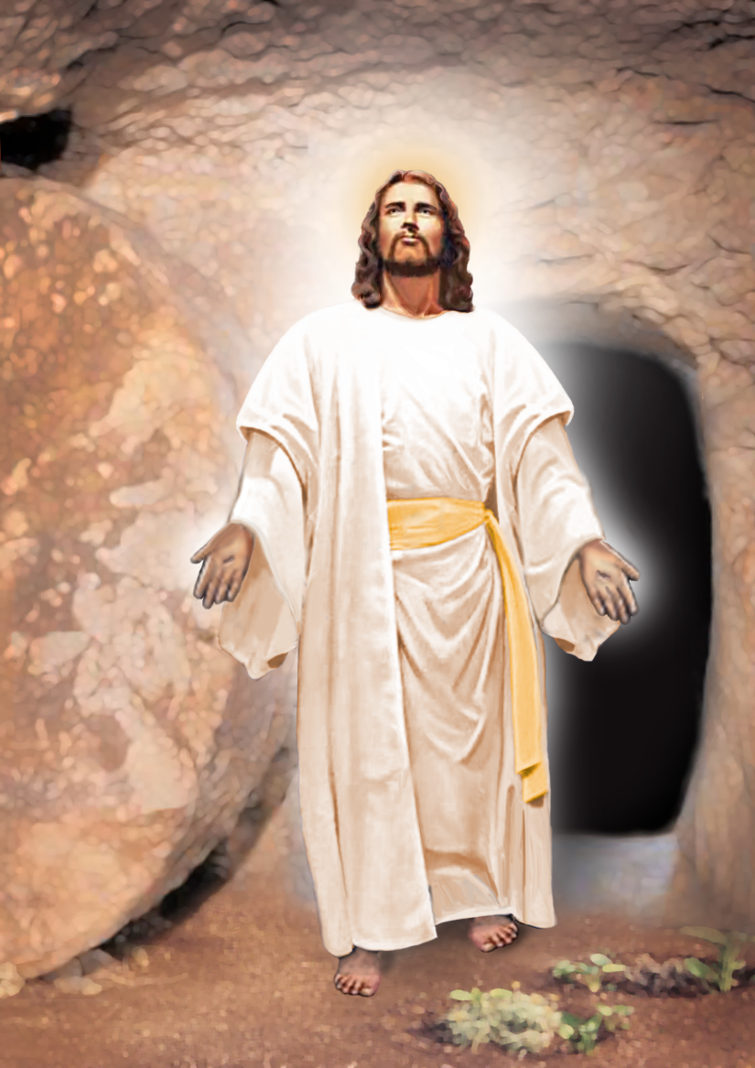
JESUS

