Slide 1
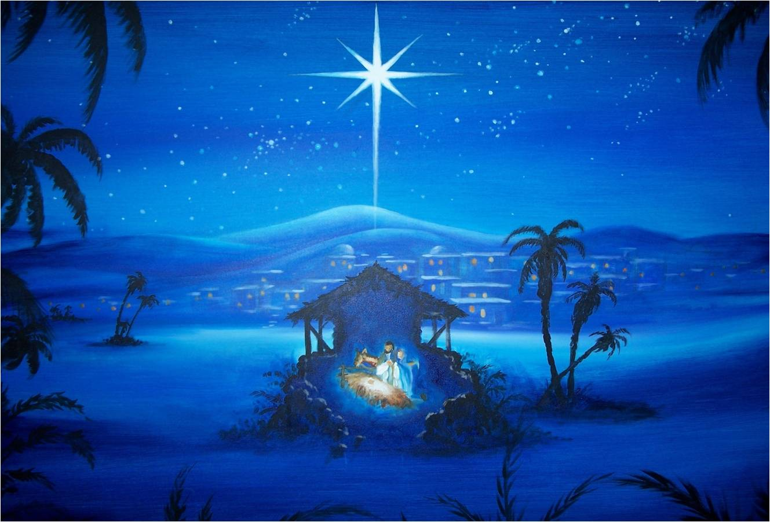
WHY JESUS CAME?
Luke 2:8-12, Matthew 1:21

Slide 2
1. Jesus came to save all people.

Slide 3
2. Jesus came to reconcile sinners to God.

Slide 4
3. Jesus came to defeat the works of Satan.

Slide 5
4. Jesus came to give our lives purpose and meaning.

Slide 6
Our purpose and meaning is:
1. To love and worship God with all of our heart, soul and mind,
2. To serve Him in all things,
3. To reach others with the gospel of Jesus Christ,
4. To make disciples and teach them to observe all that God has commanded us.

