Slide 1
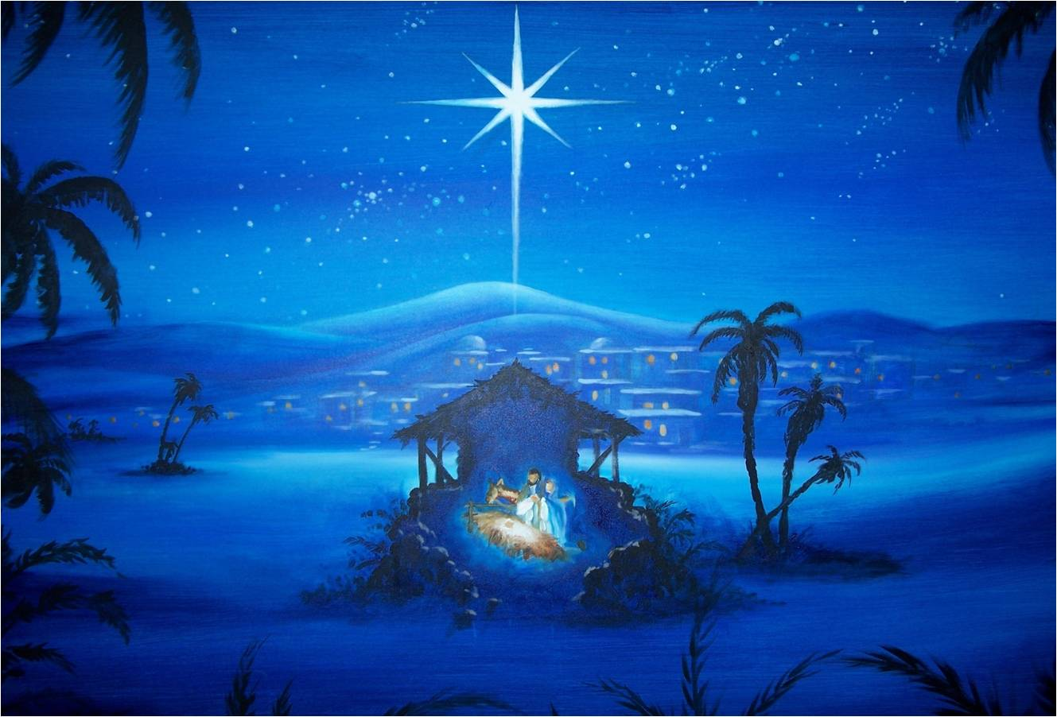
THE FIRST CHRISTMAS GIFT
GENESIS 3:14-15

Slide 2
1. The given gift.

Slide 3
2. The perfect gift.

Slide 4
3. The conquering gift.

Slide 5
4. The saving gift.

