Slide 1
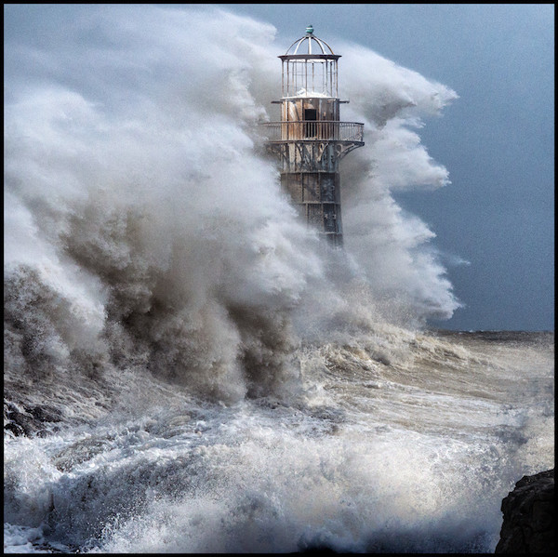
WEATHERING THE STORMS OF LIFE

Slide 2
Anchors For The
Storms of Life
Acts 27:14-29

Slide 3
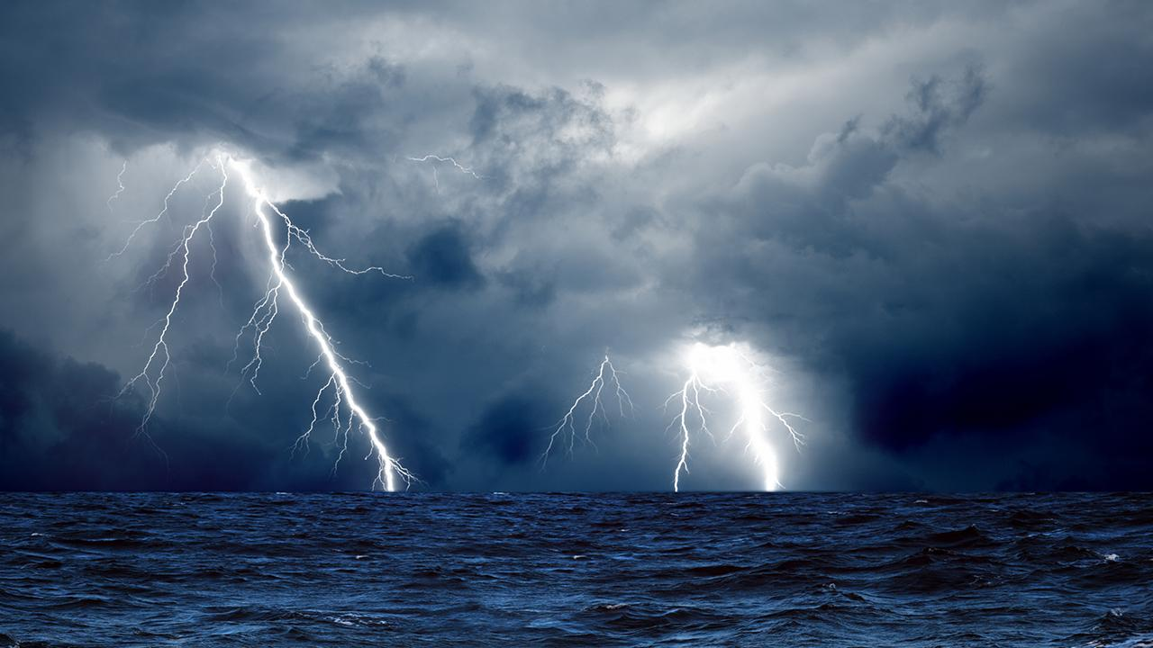
I. The Anchor of
God’s Presence.

Slide 4
II. The Anchor of
God’s Promises.

Slide 5
God’s Promises:
1. Brighter Days -
Psalms 30:5
2. Deliverance -
Psalms 34:19

Slide 6
3. Everything is for our Good - Romans 8:18; Romans 8:28;
2 Corinthians 4:17
4. Divine Grace - 2 Corinthians 12:9
5. God’s Perfect Plan – Jeremiah 29:11

Slide 7
III. The Anchor of
God’s Guidance.

Slide 8
God is sovereign.
Isaiah 45:7
God knows what is best for us.
Jeremiah 29:11

Slide 9
God works all things for my good.
Romans 8:28
God is our refuge in the storms of life.
Psalms 57:1, Isaiah 25:4

Slide 10
IV. The Anchor of
God’s Fulfillment.

