Slide 1
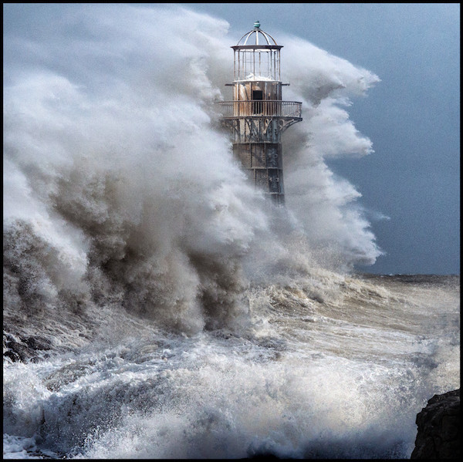
WEATHERING THE STORMS OF LIFE

Slide 2
Hidden blessings In
The Storms of Life
Matthew 14:22-33

Slide 3
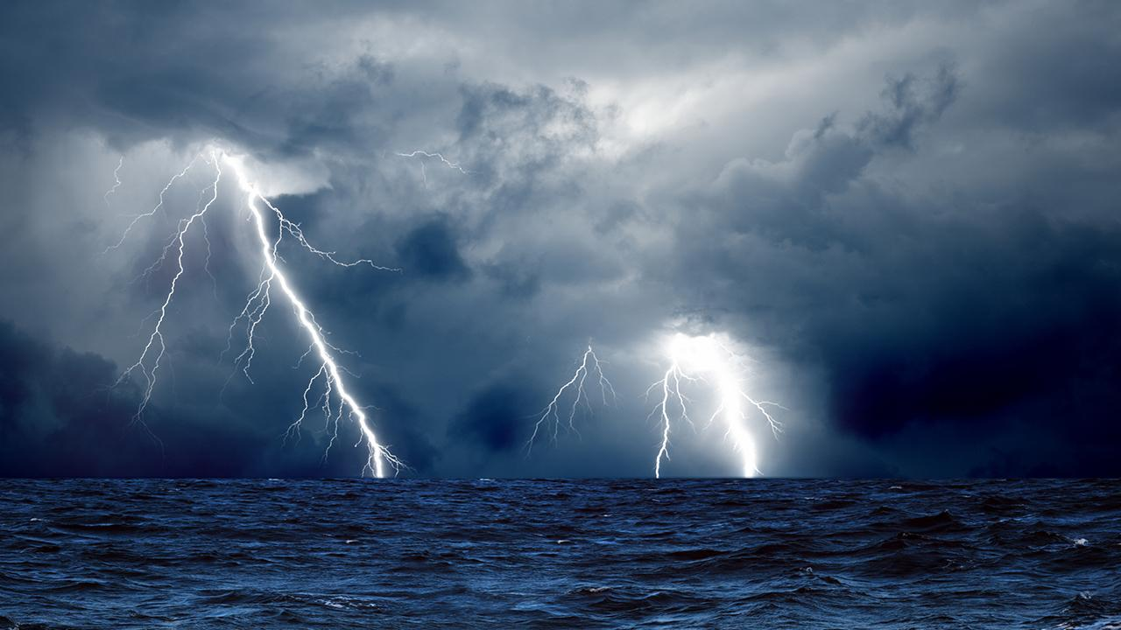
I. Storms are God’s
way of moving us.

Slide 4
II. Storms are God’s
Means of growth.

Slide 5
III. Storms are God’s
way of growing
our Testimony.

