Slide 1
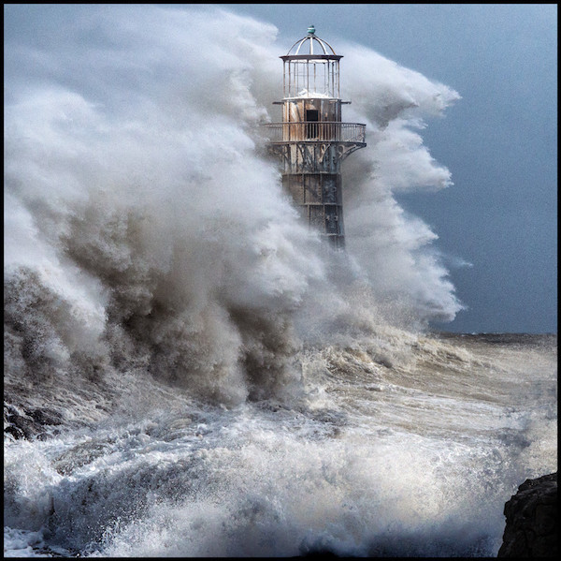
WEATHERING THE STORMS OF LIFE

Slide 2
Lessons While In
The Storm
Matthew 14:22-33

Slide 3
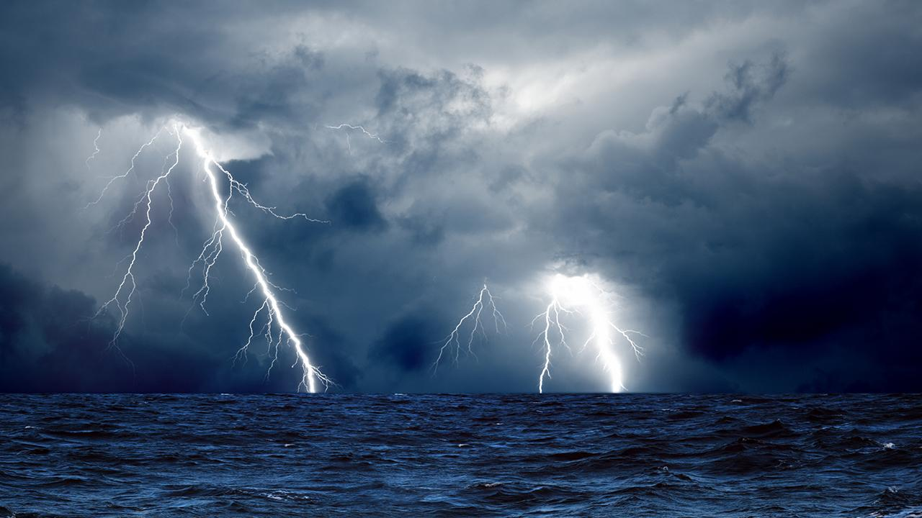
1. Faith is
increased in
the storms.

Slide 4
2. Weak faith
leads to doubt.

Slide 5
3. Doubt leads
to fear
and defeat.

Slide 6
4. Storms come
that we may
be able to
help others.

Slide 7
5. Jesus is
always there.

Slide 8
6. Salvation leads
to real life
changing worship.

Slide 9
7. God is
bigger than
your storm.

