Slide 1
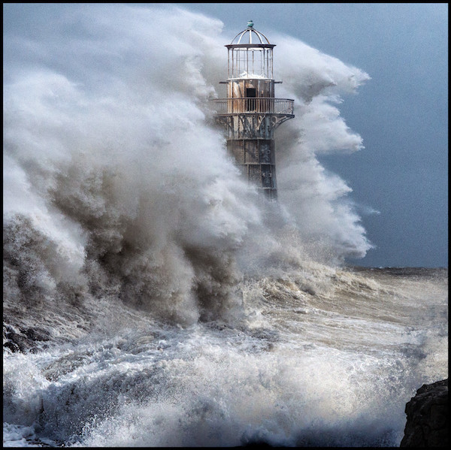
WEATHERING THE STORMS OF LIFE

Slide 2
How to Be Storm Ready
Matthew 7:24-27

Slide 3
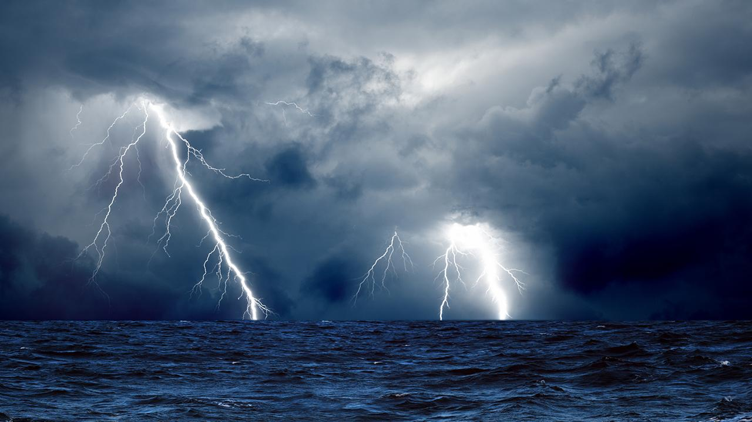
1. Start with the
right foundation.

Slide 4
2. Understand
storms are
going to come.

Slide 5
3. We weather the
storms of life
through surrender.

Slide 6
4. Listen to
the truth.

Slide 7
5. Humble yourself
under God’s hand.

