Slide 1
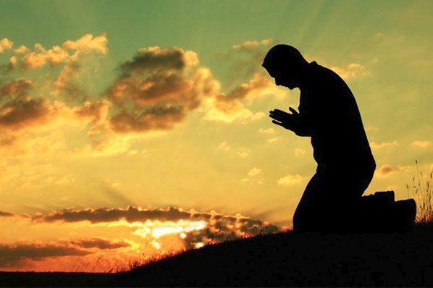
Real
Worship
Of God

Slide 2
How Do Come To Worship God
Psalm 100:1-5

Slide 3
1. We must lift our voice to God in Worship.

Slide 4
2. We must
give God
the honor.

Slide 5
3. We must draw close to God in our singing.

Slide 6
4. We must acknowledge God as the only God.

Slide 7
5. We must open the door of our heart and life to God.

Slide 8
6. We must give thanks to God.

Slide 9
7. We must bless His name.

Slide 10
Real
Worship
Of God

