Slide 1
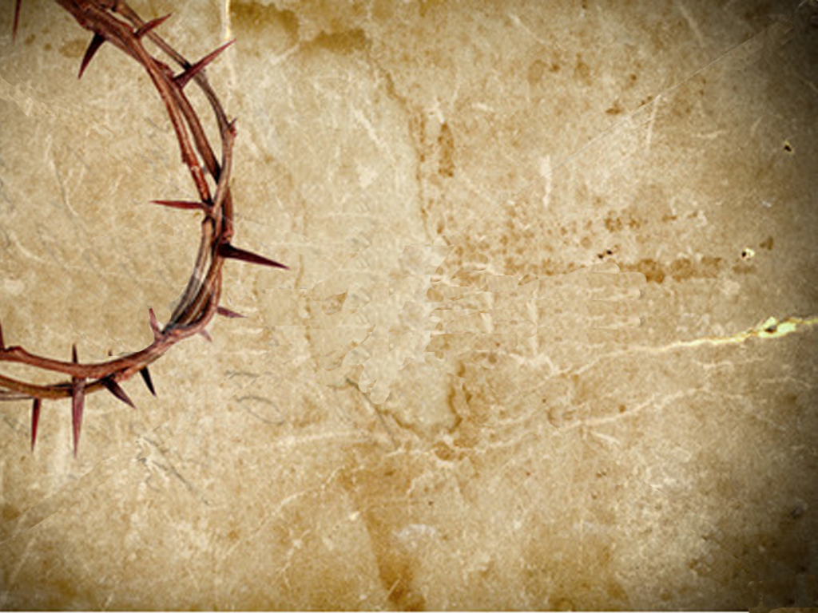
The Work of the Believer

Slide 2
Week #1 Love
Romans 12:9-10

Slide 3
I. The believer is to love others with a genuine love.

Slide 4
The word "dissimilation" means without hypocrisy and without play-acting.

Slide 5
1. The believer is to love by hating evil.

Slide 6
The word "abhor" means to hate with intense feeling, to loathe and to look upon with horror.

Slide 7
2. The believer is to love by cleaving to that which is good.

Slide 8
The word "cleave" means to join or fasten together, to attach, to cement or glue together.

Slide 9
3. The believer is to love by loving his brothers in Christ, by being kind and affectionate toward them.

Slide 10
The word "affectionate" means the love existing between family members.

Slide 11
4. The believer is to love by giving preference to other believers.

Slide 12
The word "honor" means to reverence, respect and esteem.

Slide 13
The word "preferring" means to go before, to lead and to set an example.

Slide 14
The word "preferring" means to go before, to lead and to set an example.

Slide 15
Is your love for all believers setting the example for the lost of how much God loves them?

Slide 16
Is your love for all believers setting the example for the saved for how much God loves them?

Slide 17
Week #1 Love
Romans 12:9-10

Slide 18
The Work of the Believer

