Slide 2
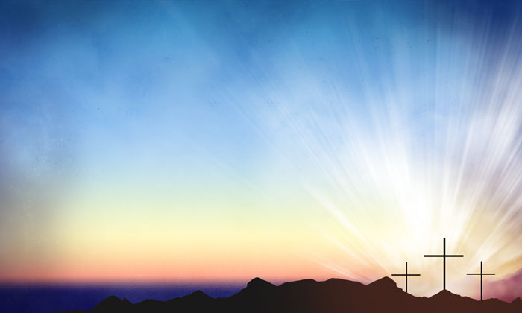
The Sunday
That Changed
Everything

Slide 3
Jesus Died.

Slide 4
Jesus was buried.

Slide 5
Jesus rose
from the grave.

Slide 6
1. We are freed from the
bondage of sin and forgiven
by Jesus’ death, burial
and resurrection.

Slide 7
2. Because of Jesus’
resurrection death
is defeated
and we don’t have to
fear death.

Slide 8
3. The Spirit of
God lives in us.

Slide 9
4. God loves
you unconditionally.

Slide 10
5. God has a greater
purpose for your life.

Slide 11
6. We have a home in
Heaven waiting for us.

