Slide 1
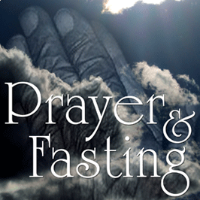

Slide 2
Reasons Why We Should Fast
Isaiah 58:6-8

Slide 3
Definition for fasting for our series: Fasting is a voluntary abstaining from something for a specified period of time to specifically seek God and to grow spiritually.

Slide 4
1. The Disciple’s Fast.
Matthew 17:14-21

Slide 5
The Disciple’s Fast is Fasting for freedom from addiction.

Slide 6
Fasting increases the authority of prayer.

Slide 7
Fasting increases our faith.

Slide 8
The cure for unbelief is prayer and fasting.

Slide 9
2. The Ezra Fast.
Ezra 8:21-23

Slide 10
The Ezra fast is fasting to solve problems or burdens.

Slide 11
3. The Samuel Fast.
1 Samuel 7:1-8

Slide 12
The Samuel fast is fasting for revival and to win people to Christ.

Slide 13
I challenge you to do that this week! Fast for revival and salvation of souls.

Slide 14
4. The Elijah Fast.
1 Kings 19:2-18

Slide 15
The Elijah fast is fasting to break crippling fears, mental and emotional problems.

Slide 16
5. The Widow’s Fast.
1 Kings
17:12-16

Slide 17
The Widow’s fast is fasting to provide for the needy.

Slide 18
6. The Saint Paul Fast.
Acts 9:9-19

Slide 19
The Saint Paul fast is fasting for insight into decision making and seeking for God’s will.

Slide 20
This Saint Paul fast is really 2 fold.

Slide 21
First, is when you’re seeking God’s will in a major area of life.

Slide 22
Second, is when we want to know God’s will.

Slide 23
7. The Daniel Fast.
Dan. 1:8-20

Slide 24
The Daniel Fast is fasting for healthier life and physical healing.

Slide 25
8. The John the Baptist Fast.
Matthew 3:4, Luke 1:15

Slide 26
The John the Baptist Fast is fasting for a more righteous life and a more influential testimony.

Slide 27
9. The Esther Fast.
Esther 4:16; 5:2

Slide 28
The word rereward means protection.

Slide 29
The Esther Fast is fasting for protection from the evil one.

