Slide 1
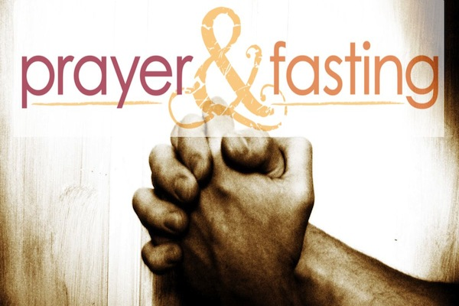

Slide 2
Guidelines for Fasting
Matthew 6:16-18

Slide 3
Definition for fasting for our series: Fasting is a voluntary abstaining from something for a specified period of time to specifically seek God and to grow spiritually.

Slide 4
1. Fasting is not to be done Hypocritically.

Slide 5
2. Fasting is to be done Privately.

Slide 6
3. Fasting is to be done Purposefully.

Slide 7
4. Fasting is to be done Prayerfully.

Slide 8
The pattern Jesus gives for prayer: Matthew 6:9-13
Worship— Our Father which art in heaven, Hallowed be thy name.
B. Submission— Thy kingdom come. Thy will be done in earth, as it is in heaven.

Slide 9
C. Provision— Give us this day our daily bread.
D. Forgiveness— And forgive us our debts, as we forgive our debtors.
E. Protection— And lead us not into temptation.

Slide 10
F. Deliverance— but deliver us from evil.
G. Worship— For thine is the kingdom, and the power, and the glory, for ever.

Slide 11
5. Fasting is not a Ritual.

Slide 12
6. Fasting must always start with Repentance.

Slide 13
Fast Challenge: Give up 30 minutes each day of tv, phone and social media up this week.
1. Pray for God to radically move in your life spiritually and grow you.
2. This week put away all rituals and prayerfully seek God in true humble repentance.

