Slide 1
IT IS FINISHED John 19:28-30

Slide 2
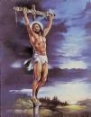
1. The Sacrifice was Acceptable.

Slide 3
2. The Scriptures were Fulfilled.

Slide 4
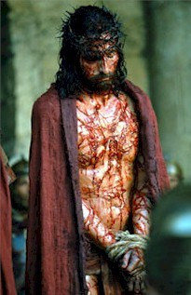
3. His Sufferings were over.

Slide 5
4. The Devil was Defeated.

Slide 6
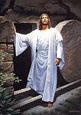
5. Victory was won.

Slide 7
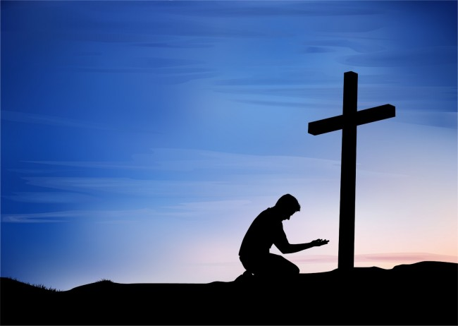
6. Salvation was complete and available.

