Slide 1
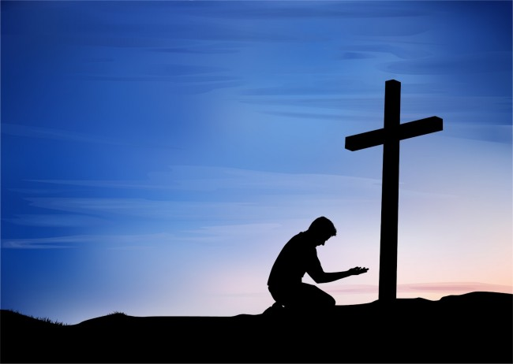
Salvation From the Cross
Luke 23:39-43

Slide 2
I. The repentance of a sinner.

Slide 3
II. The revelation of salvation.

Slide 4
III. The reward of the Savior.

