Slide 1
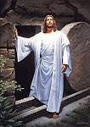
The Resurrection is Proof Matthew 28:1-10

Slide 2
I. The resurrection is proof of our hope.

Slide 3
II. The resurrection is proof of God’s grace.

Slide 4
III. The resurrection is proof of God’s love.

