Slide 1
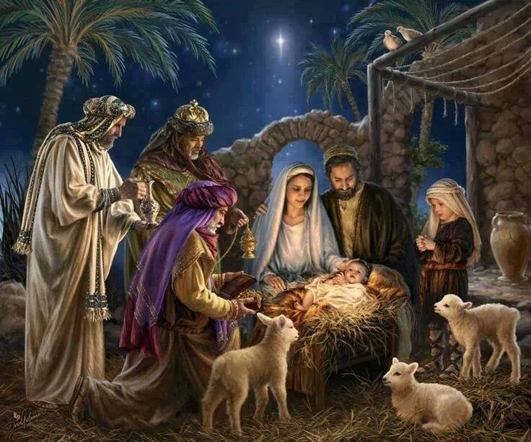

Slide 2
Joseph: Godly or Ungodly?
Matthew 1:18-26

Slide 3
1. Integrity reveals who you truly are.

Slide 4
2. Adversity reveals our spiritual character.

Slide 5
3. When we obey God, we experience His blessings.

Slide 6
4. Making a stand for God will always means going against the flow.

