Slide 2
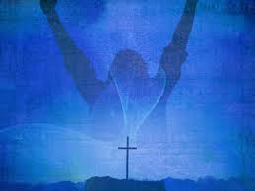
Ending
a Drought.

Slide 3
II. Revival means change.
Ezekiel 36:26—²⁶ A new heart also
will I give you, and a new spirit
will I put within you: and I will
take away the stony heart
out of your flesh, and I
will give you an heart of flesh.

Slide 4
Call on
the Lord v.1

Slide 5
2. Confront
the Issues. V.2-5

Slide 6
3. Bury the
Bones. V.12-14

