Slide 1
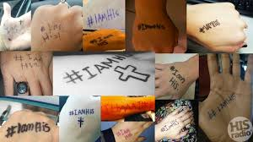

Slide 2
#IamHIS Joshua 24:15

Slide 3
100,000 Christian die each year for the Christian faith
273 a day
11 an hour

Slide 4
I. If I am His I will take a stand for Him.
1. If I am going to stand for Christ I must:

Slide 5
Courageous Faith
Strong Conviction
Trusting Faith

Slide 6
II. If I am His I will not be ashamed of Him.

Slide 7
III. If I am His I will suffer the consequences.

Slide 8
#IamHIS

