Slide 1
People God Uses Hebrews 11:32-34

Slide 2
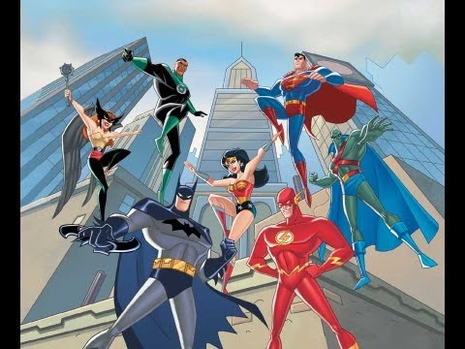

Slide 3
1. God uses ordinary people.

Slide 4
2. God uses forgiven people.

Slide 5
3. God uses courageous people.

Slide 6
4. God uses
careful
people.

Slide 7
5. God uses convinced people.

