Slide 1
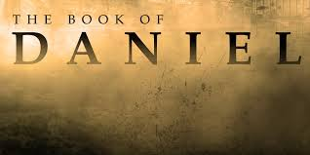
Courageous Living in an
UPSIDE DOWN
World

Slide 2
Nebuchadnezzar:
A Plan to
Change God’s People
Daniel 1:1-7

Slide 3
Nebuchadnezzar plan to change God’s people:

Slide 4
1. He wanted to change their Language.

Slide 5
2. He wanted to change their way of Thinking.

Slide 6
3. He wanted to change their Lifestyle.

Slide 7
4. He wanted to change their Loyalty.

Slide 8
Daniel = God is Judge.
changed to Belteshazzar - Bel will protect (Bel, a Babylonian god)

Slide 9
Hananiah = God is Gracious.
changed to Shadrach - command of Aku (Aku was the Babylonian moon god)

Slide 10
Azariah = God is my Help.
changed to Abednego - servant of Nebo (Nebo was a Babylonian god)

Slide 11
Mishael = Who is like God?
changed to Meshach - who is like Aku. (Babylonian moon god)

Slide 12
Courageous Living in an
UPSIDE DOWN
World

