Slide 1
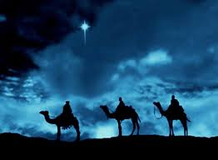
The Three Seekers Matthew 2:1-15

Slide 2
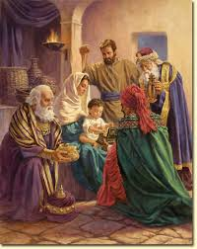

Slide 3
I. 7 Lessons from the Wise Men:

Slide 4
1. The wise men met God in the midst of their work.

Slide 5
2. They found their way by consulting Scripture.

Slide 6
3. They gave themselves in worship first.

Slide 7
4. They gave the gifts they had.

Slide 8
5. If the Wise Men can find Jesus, so can you.

Slide 9
6. If God can use a star to reach the wise men, he can use anything to reach you.

Slide 10
7. They were willing to take action.

Slide 11
II. There were 3 Responses to the Christmas story.

Slide 12
1. The Wise Men were eager to seek Jesus.

Slide 13
2. King Herod was hostile to Jesus.

Slide 14
3. The Religious Leaders were apathetic.

Slide 15
Are you eager to seek Jesus, Hostile to Jesus or Apathetic and don’t care?
Where are you?

Slide 16
How will you respond to Jesus?

