Slide 1
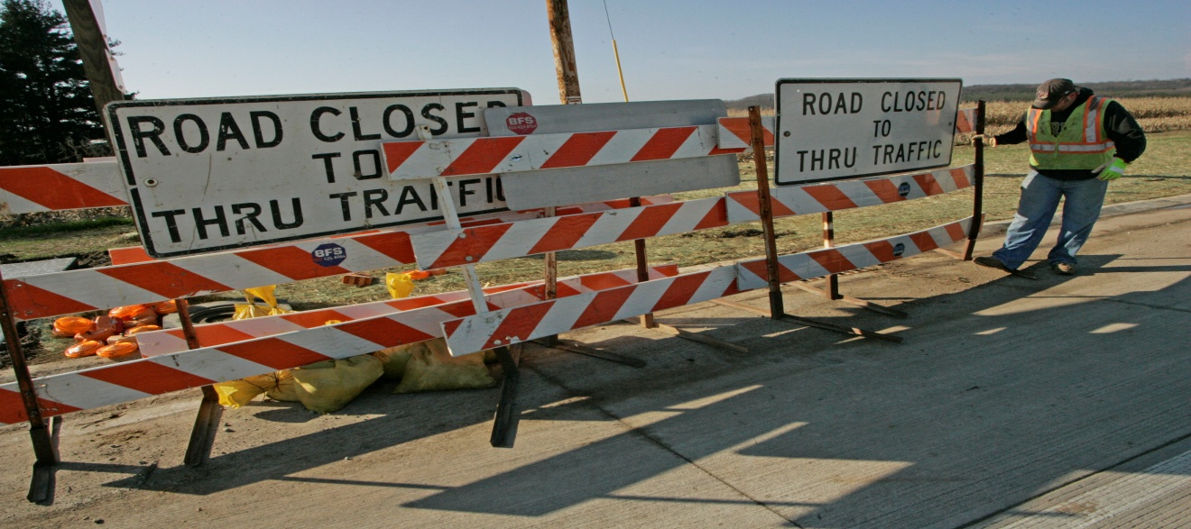
OBSTACLES

Slide 2
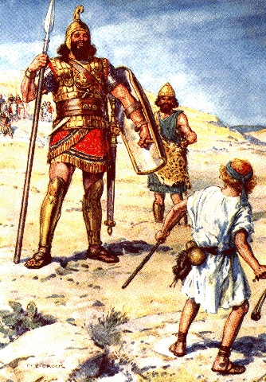
OBSTACLES
1 Samuel
17:1-54

Slide 3
1. Everyone faces obstacles.

Slide 4
Goliath
9’9”- 10’8”
Shaquille O’Neil
7’1”
David
Around 5’2”

Slide 5
John 16:33 (GW)—³³ I've told you this so that my peace will be with you. In the world you'll have trouble. But cheer up! I have overcome the world.”

Slide 6
Acts 8:1 (KJV)—¹ And Saul was consenting unto his death. And at that time there was a great persecution against the church which was at Jerusalem; and they were all scattered abroad throughout the regions of Judaea and Samaria, except the apostles.

Slide 7
2. Obstacles can cause great fear in our life.

Slide 8
2 Timothy 1:7—⁷ For God hath not given us the spirit of fear; but of power, and of love, and of a sound mind.

Slide 9
3. Obstacles can be overcomed.

Slide 10
Ephesians 6:13 (GW)—¹³ For this reason, take up all the armor that God supplies. Then you will be able to take a stand during these evil days. Once you have overcome all obstacles, you will be able to stand your ground.

Slide 11
Romans 12:21 (KJV)—²¹ Be not overcome of evil, but overcome evil with good.

Slide 12
4. Obstacles with God become opportunities for greatness.

Slide 13
5. Obstacles lead to faith growth.

Slide 14
John 11:15 (KJV)—¹⁵ And I am glad for your sakes that I was not there, to the intent ye may believe; nevertheless let us go unto him.

Slide 15
OBSTACLES

