Slide 1
National Donor Sabbath
LifePoint, SC
Donate Life, SC

Slide 2
Pelham M. Medlock Jr.
Chief Arson Investigator (Retired)
Employment & Positions
Consultant & Expert 2007- present
Investigator – Incident Investigative Unit – SGFD 2007 - 2009
Retired Chief Arson Investigator 2006 – present
Chief Arson Investigator – Anderson County Arson Unit 2000 – 2006
Acting Chief Arson Investigator – Anderson County Arson Unit 1999 – 2000
Arson Investigator – Anderson County Arson Unit 1994 – 1999
County Fire Chief – Anderson County Fire Department 1992 – 1994
County Training Supervisor – Anderson County Fire Department 1992 – 1992
Engineer to Captain – South Greenville Fire Department 1988 – 1992
Service Department – Jennings & Dill Mechanical Contractor 1987 – 1988
Dispatcher to Engineer – South Greenville Fire Department 1983 – 1987

Slide 3
Organ Donation
& The Bible

Slide 4
15 Areas In Old Testament
14 Areas In New Testament
Over 80 Verses In The Bible

Slide 5
Organ Donation & Religion
Old Testament
Genesis 2:20-30 Psalm 113
Leviticus 1:7 Psalm 116
Deuteronomy 30:15-20 Psalm 145
Psalm 41 Psalm 147
Psalm 100 Ecclesiastes 3:1-17
Psalm 107 Isaiah 35:1-6
Psalm 111 Isaiah 40:31
Ezekial 37

Slide 6
Organ Donation & Religion
New Testament
Matthew 5:7 Luke 14:12-14
Matthew 7:7 John 3:16-17
Matthew 7:12 John 10:10
Matthew 25: 31-46 John 11:25
Luke 4:16-21 John 15:12-17
Luke 6:37-38 II Corinthians 9:6-8
1 John 4:11
Revelation 21:4-5

Slide 7
Revelation 21:4-5
⁴And God shall wipe away all tears from their eyes; and there shall be no more death, neither sorrow, nor crying, neither shall there be any more pain: for the former things are passed away.
⁵And he that sat upon the throne said, Behold, I make all things new. And he said unto me, Write: for these words are true and faithful.

Slide 8
John 3:16
¹⁶ "For God loved the world in this way: He gave His One and Only Son, so that everyone who believes in Him will not perish but have eternal life.

Slide 10
Today 21 People
Will Be Removed From The Waiting List
Because They Died
Every 10 Minutes
A New Person Is Added
1 Donor Can Save Up To 8 Lives

Slide 11
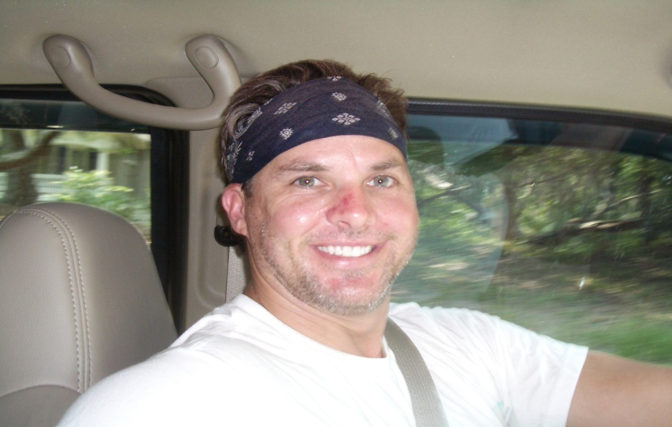
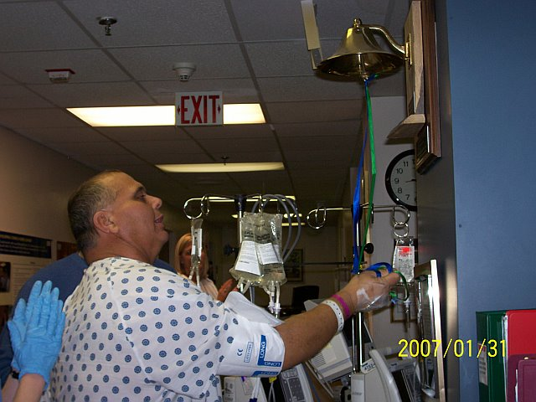
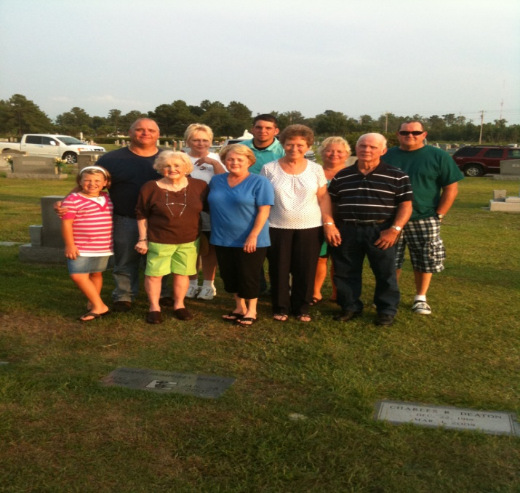
My Donor
Shawn Bissell
Our Family
Ringing The Bell

Slide 12
On The US Waiting List Candidates
As Of November 1, 2014
At 10:03 PM There Was 124,074
16,884 Total Transplants
January - July 2014
8,279 Total Donors
January - July 2014

Slide 13
In South Carolina
There Is 856 On The Waiting List
Kidney – 725
Liver – 59
Pancreas – 13
Kidney / Pancreas – 47
Heart – 11
Lung - 1

Slide 14
Matthew 7:12
¹² Therefore, whatever you want others to do for you, do also the same for them—this is the Law and the Prophets.

